Slide 1
Driver Drowsiness Detection System
MINOR PROJECT
Members :
Gajendra Singh(19100BTCSES05371)
Manish Lohar (19100BTCSES05382)
Shashwat Pagnis (19100BTCSES05400)
Vinayak Ojha(19100BTCSES05405)
Mentor:
Prof. Shyam Sundar Meena

Slide 2
Problem
Road accidents take many lives every year, and one of the causes of road accidents is sleepy drivers. Being a potential cause for danger on the road, one of the best ways to prevent this is to implement a drowsiness detection system.

Slide 3
Technologies to be used
Language : Python
Libraries:
Numpy
Pandas
Keras
Opencv
Pygame
Time
OS
This project is based on the concepts of Data Science.

Slide 4
why this
A driver drowsiness detection system such as this is yet another project that has the potential to save many lives by constantly assessing the driver’s eyes and alerting him with alarms in case the system detects frequent closing of eyes.
Need of this project in real world

Slide 5
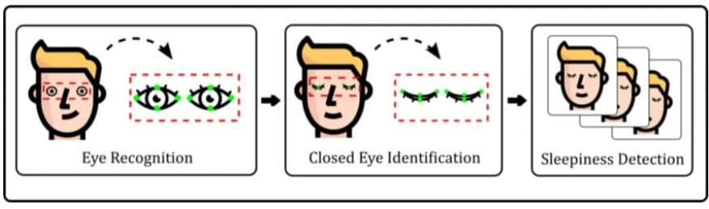
Flow of proposed model

Slide 6
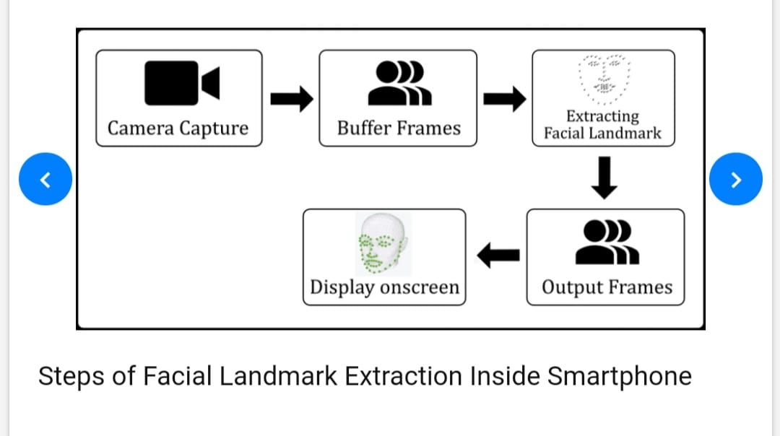
Facial Landmark detection
Steps of Facial landmark detection from Camera

Slide 7
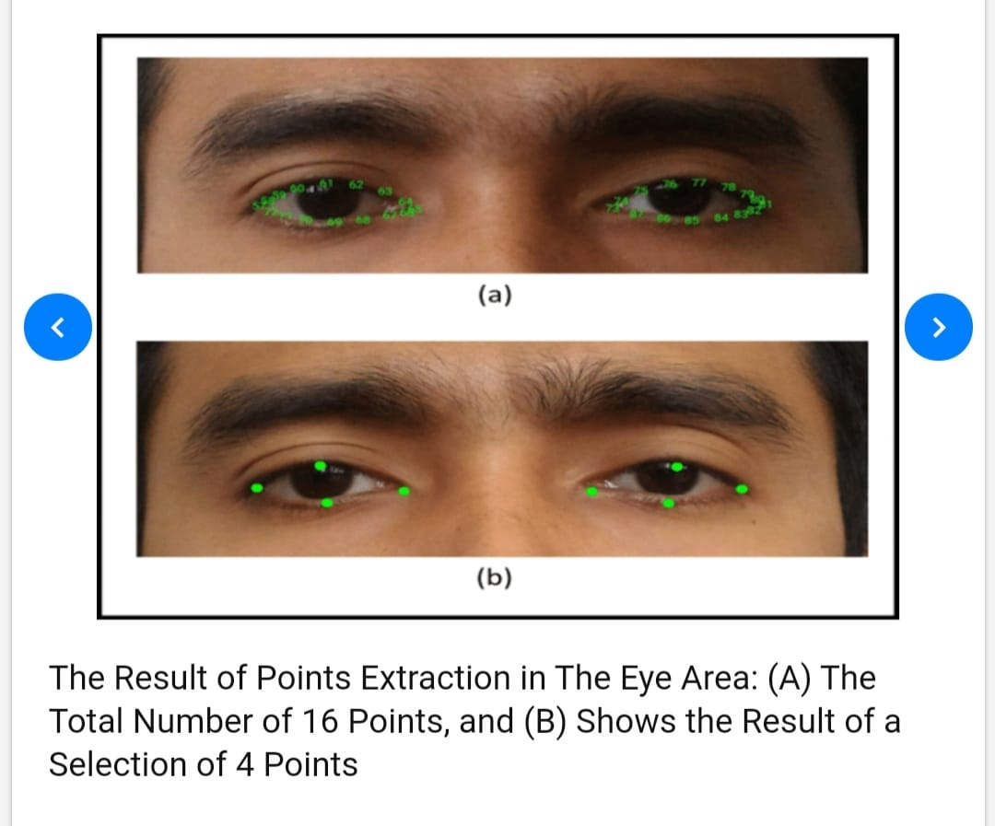
Result
The result of points extraction in the eye area
The total number of 16 points.
The result of selected 4 point.

Slide 8
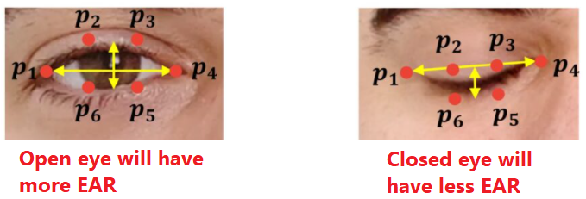
How to find Eye Aspect Ratio(EAR):
Each eye is represented using 6 landmarks points.

Slide 9
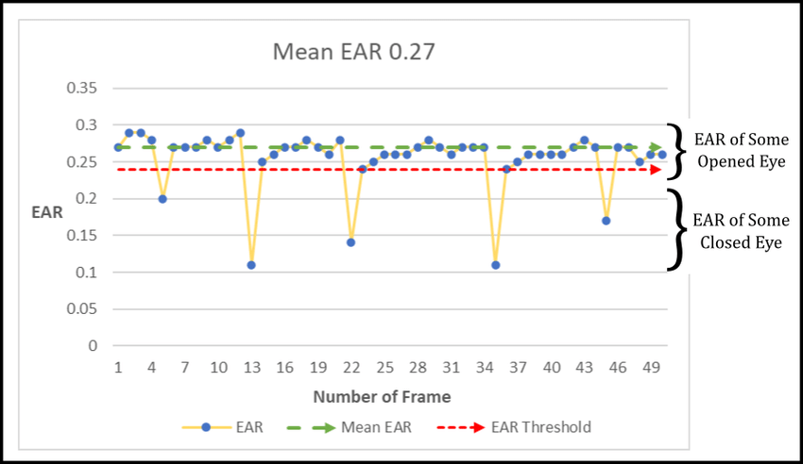
An Illustration of Relation between The Mean EAR of Opened Eye with The Variation of EAR Threshold.

Slide 10
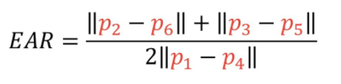
The EAR for a single eye is calculated using this formula:
The more the EAR, the more widely eye is open. We would decide a minmum EAR value and used this to decide if the eye is closed or not.

Slide 11
Libraries:-
Currently learning OpenCv for face and eye recognition.
We will detect face in the image and create region of interest.
We will use haar casacade classifier to detect faces.
We will extract only the eyes data from the full image.
Then fed into CNN classifier which will predict if eyes are open or closed.
Tensorflow to use transfer learining models
Pickle to save and open data set
Pygmae (mixer) to play alarm

Slide 12
Transfer learning technique
Transfer learning (TL) is a research problem in machine learning (ML) that focuses on storing knowledge gained while solving one problem and applying it to a different but related problem. For example, knowledge gained while learning.
We will be using already trained mobilenet neural network present in tensorflow.keras.applications

Slide 13
MobileNetV2 - Light Weight Model (Image Classification) by Google
MobileNet is a class of CNN that was open-sourced by Google, and therefore, this gives us an excellent starting point for training our classifiers that are insanely small and insanely fast.
In MobileNetV2, there are two types of blocks. One is residual block with stride of 1. Another one is block with stride of 2 for downsizing.
There are 3 layers for both types of blocks.
This time, the first layer is 1×1 convolution with ReLU6.
The second layer is the depthwise convolution.
The third layer is another 1×1 convolution but without any non-linearity. It is claimed that if ReLU is used again, the deep networks only have the power of a linear classifier on the non-zero volume part of the output domain.

Slide 14
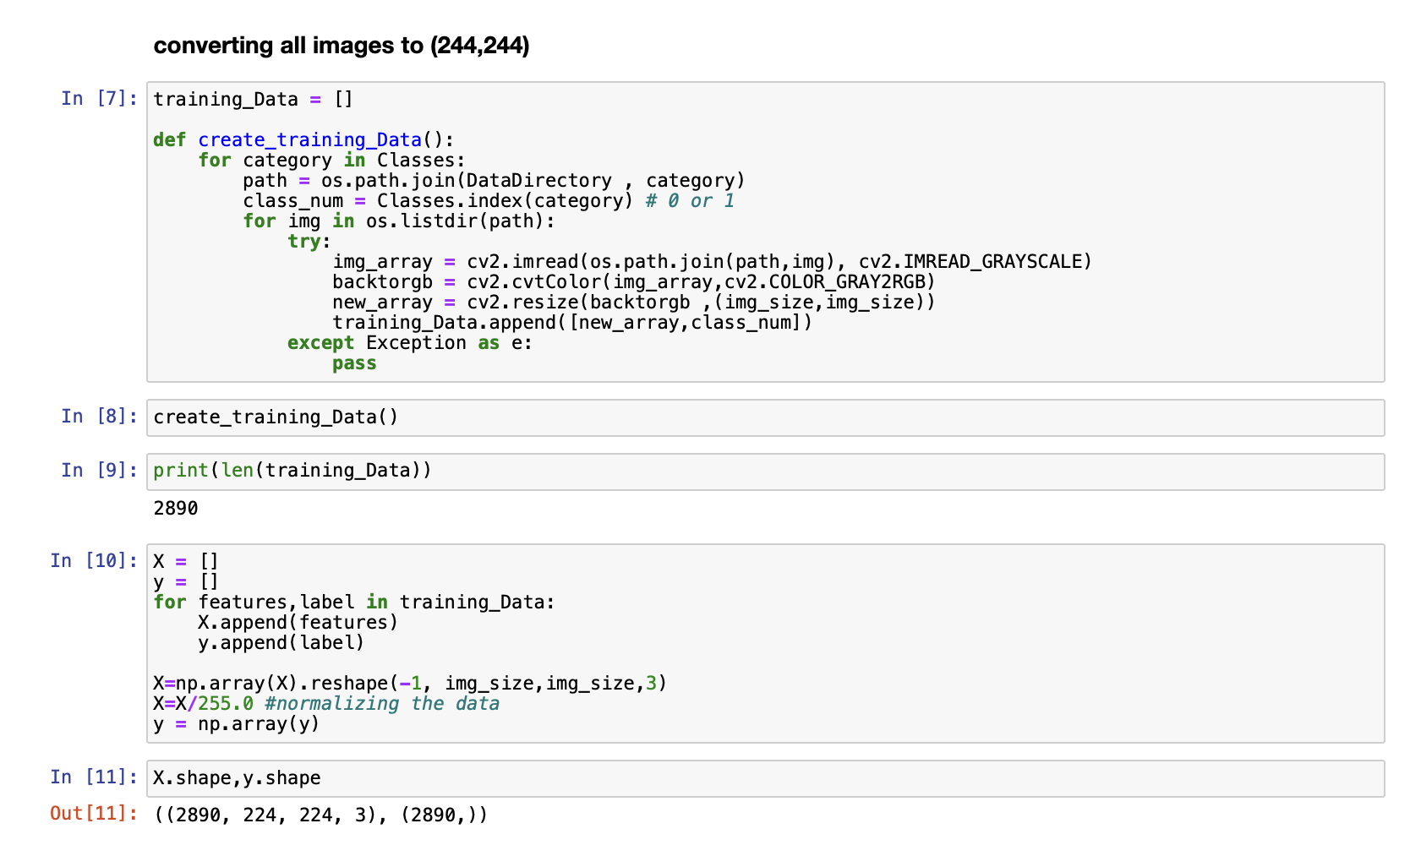
Creating train data set

Slide 15
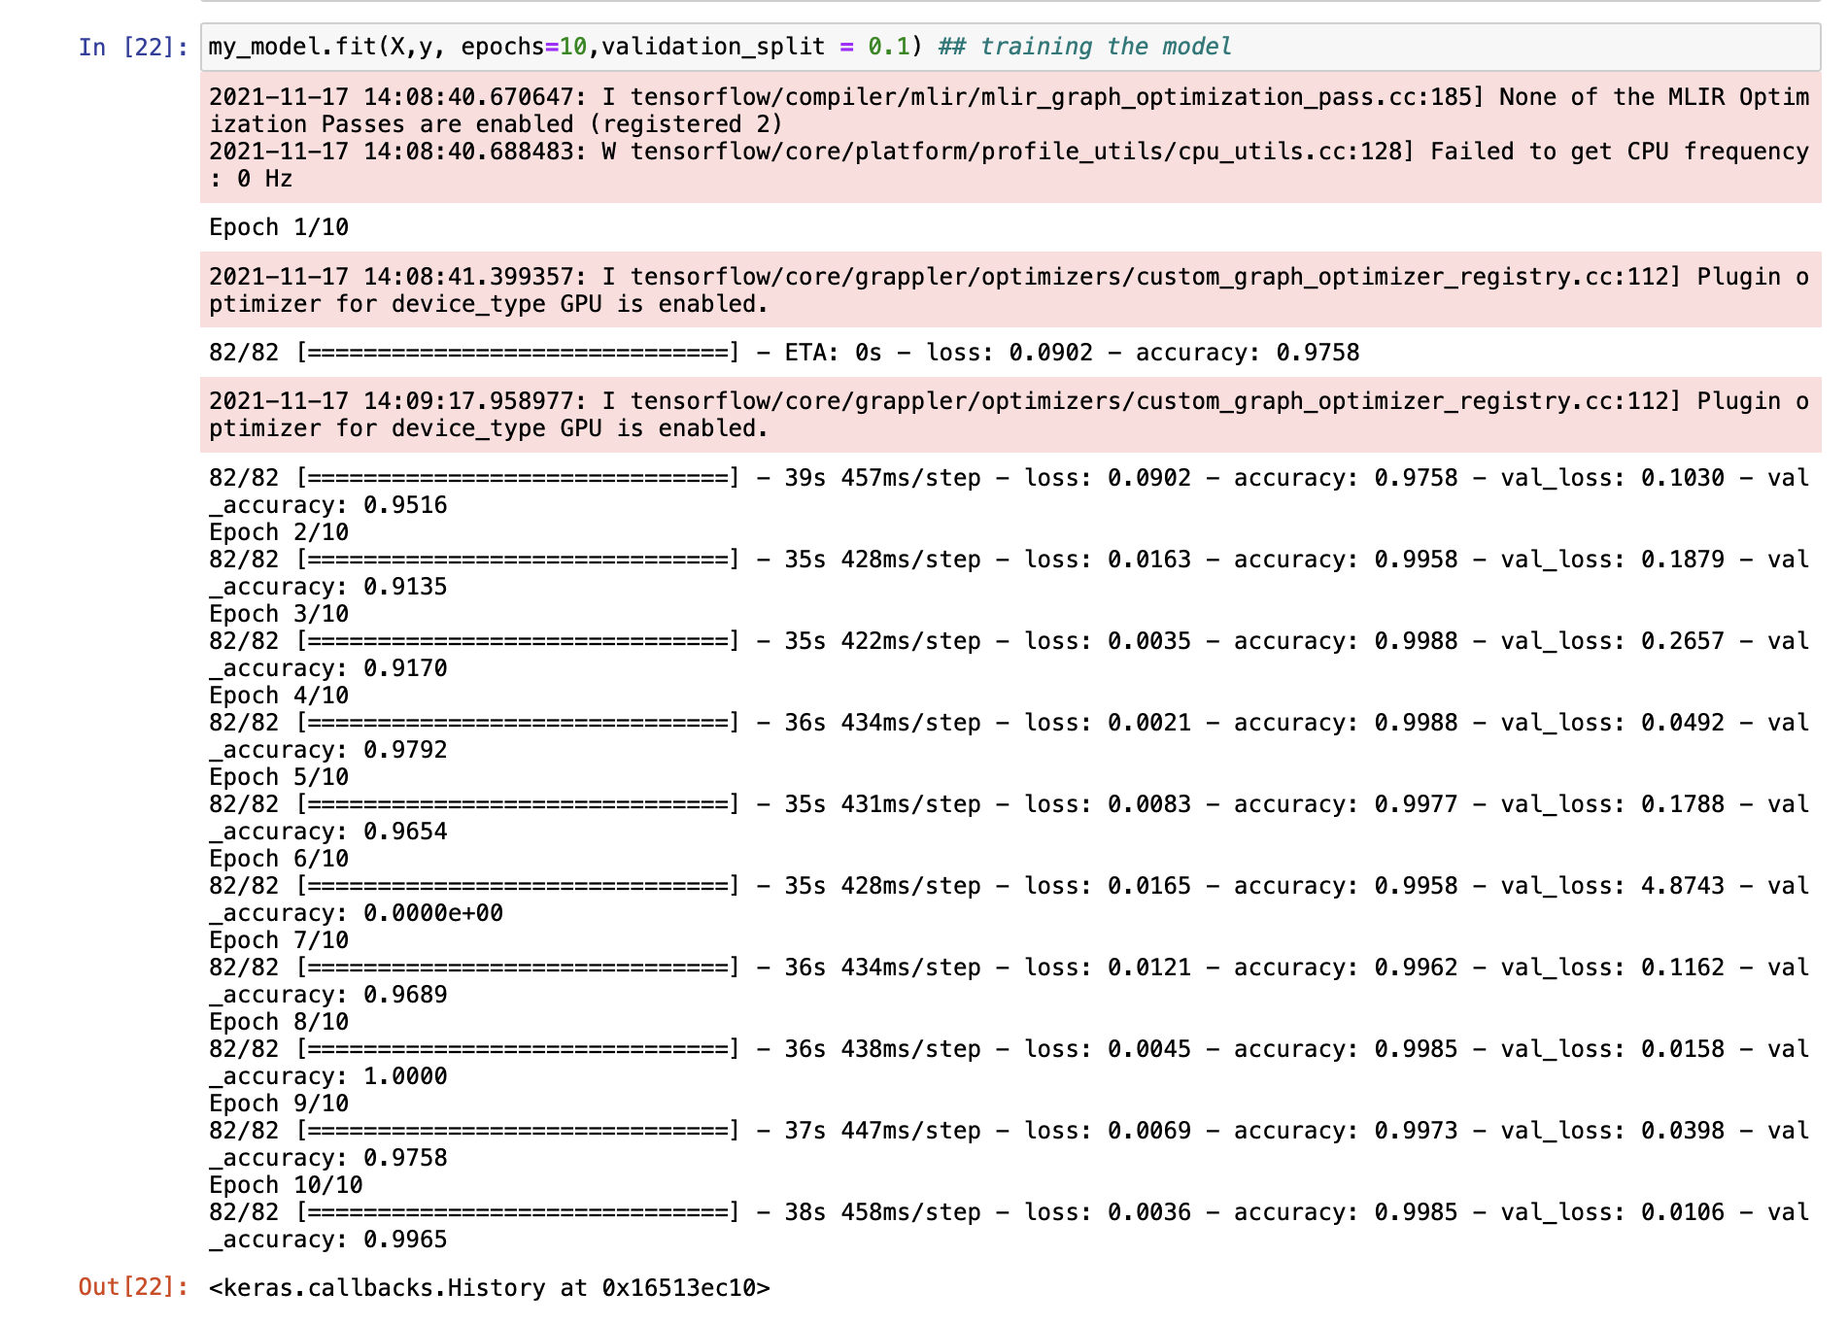
Training for 10 epochs or number of passes

Slide 16
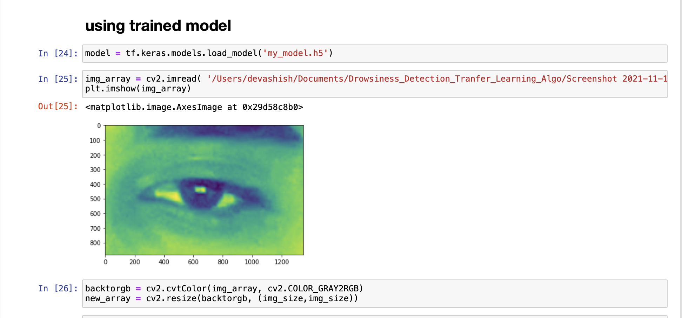
Testing trained model for unknown images.

Slide 17
